Slide 1

AB Testing
Eliel
José
Rui

Slide 2
Vanguard background
Vanguard is one of the largest investment management funds in the world.
Its model is based on an investor friendly practices with focus on the long term capitals.
With all the competitors and challenges of the new digital area, new design and new features of the web services needed to be evaluated and tested.

Slide 3
Descriptive statistics
Tableau

Slide 4
KPI’s
Completion Rate
Test dependency of the group type and successful operation
Time Spent on a successful operation
Test group spends less time than control group
Error
- We define error when client return to “start”
- When steps don’t follow the correct order timewise

Slide 5
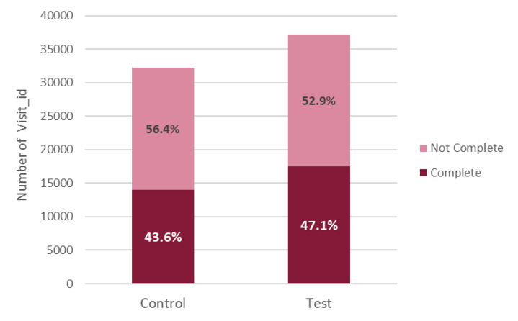
Completion Rate
H0: The "group type" and the success of the operation is independent
H1: The "group type" and the success of the operation is dependent
α = 0.05
Chi Square Test
p-value = 7.97E-21
Cramer’s-V-effect size : 0,036

Slide 6
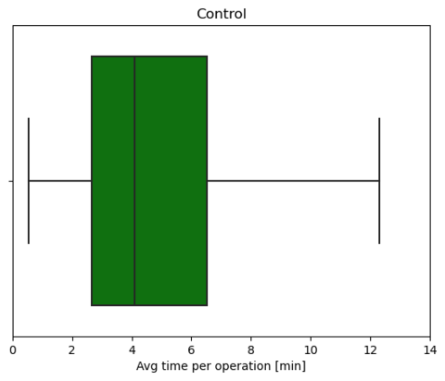
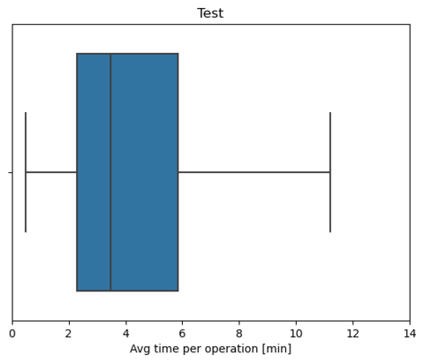
Average time spent on a successful operation
H0: Average time spent on a successful op. on: TEST >= CONTROL
H1: Average time spent on a successful op. on: TEST < CONTROL
α = 0,05
Two sample T-test
p-value= 0,07

Slide 7
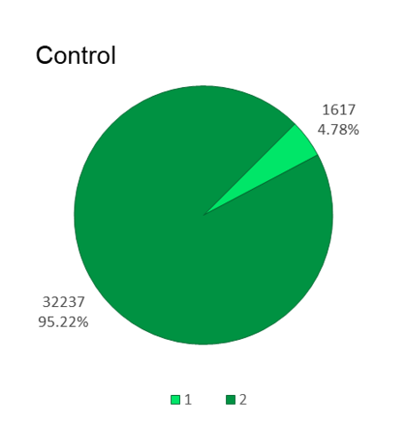
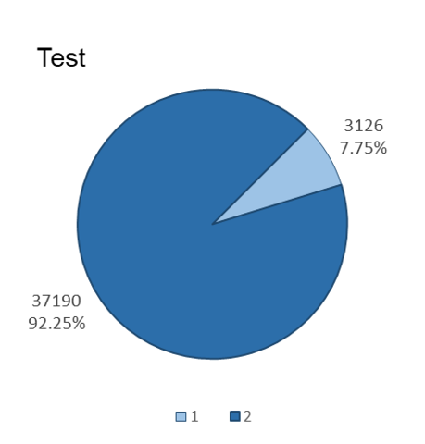

Error “return to start”
H0: Ratio of errors "return to 'start'": CONTROL >= TEST
H1: Ratio of errors "return to 'start'": CONTROL < TEST
α = 0,05
z-test for proportions
p-value= 4,66E-70
Notes:
The z-test is a statistical test for comparing the proportions from two populations.

Slide 8
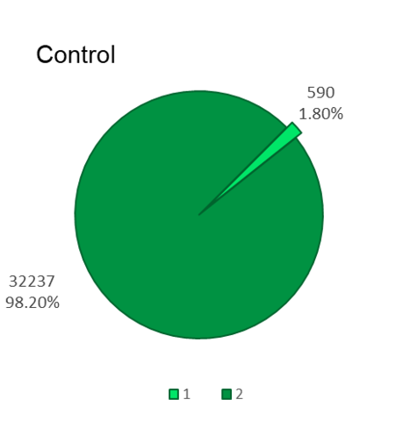
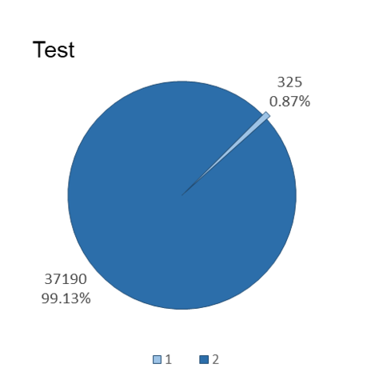

Error “timestamp readings”
H0: Ratio of 'Timestamp' readings errors: CONTROL <= TEST
H1: Ratio of 'Timestamp' readings errors: CONTROL > TEST
α = 0,05
z-test for proportions
p-value = 1.54E-28

Slide 9
Conclusions
From the results we obtained, we can see that there are differences between test and group control.
For completion rate we verified that there is a dependency between test and control group
For timestamp error, test group have statistically better results than the control group.
For time spent and return to start error, control group have statistically better results.
With this insights, the product needs to be improved and more data is necessary to evaluate the efficiency of the new product.

